Slide 1


Language Detection and Translate​

Slide 2
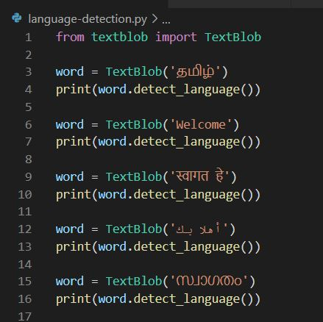
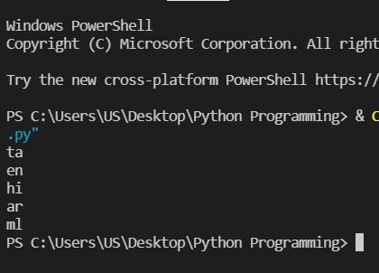
Language Detection
Python Snippet
If there any issues in output
Add the below as the 1st line in the code
# - *- coding: utf- 8 - *-
Output

Slide 3
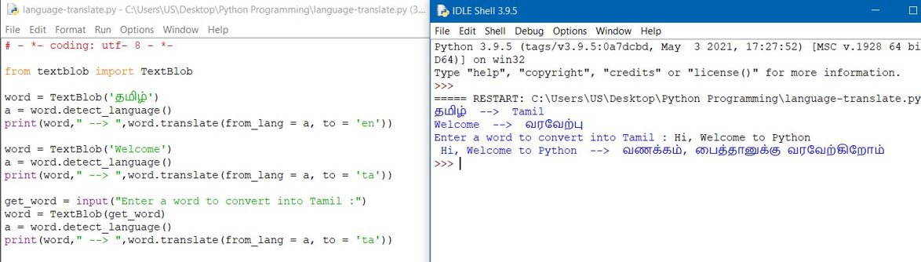
Language Translate

